Slide 1


Félix Fernández
2024-01-23

Slide 2

Outline
Executive Summary
Introduction
Methodology
Results
Conclusion
Appendix

Slide 3
Executive Summary
The methodologies were used to analyze data:
Data collection using web scrapping and SpaceX API.
EDA (Exploratory Data Analysis) with Python and SQL.
Machine Learning Models for predictions.
Summary of all results
We collected valuable Data from Public Resources.
With EDA we identify valuable information from the Data and which features uses to use for the prediction models.
Identify the best model and features for the best use to the Machine Model Prediction.

Slide 4
Introduction
With this project for the Space Y enterprise the idea is could be a serious competitor to Space X in the industry.
The problem that we solved with this project is what strategies we can use to optimize the cost from launches, predicting the success pf the launch and where is the best place to make launches.

Slide 5

Section 1

Slide 6
Methodology
Executive Summary
Data collection methodology:
The Data was collected from two sources:
Using the Space X API (https://api.spacexdata.com/v4/launches/past )
With Web Scrapping (https://en.wikipedia.org/wiki/List_of_Falcon_9_and_Falcon_Heavy_launches)
Perform data wrangling
Here we enrich the Data collected by creating a landing outcome label after analyzing the Data.

Slide 7
Methodology
Perform exploratory data analysis (EDA) using visualization and SQL
We were able to answer various questions and find valuable aspects for our objectives.
Perform interactive visual analytics using Folium and Plotly Dash
Using these tools we were able to find the places and visualize where the successful and unsuccessful launches were carried out.
Perform predictive analysis using classification models
We used a very well structured strategy that concluded with obtaining the best parameters for each model and knowing which model has the greatest precision.

Slide 8
Data Collection
Data sets was collected using Space X API (https://api.spacexdata.com/v4/launches/past. ) and using Web Scrapping techniques and extracting the data from Wikipedia (https://en.wikipedia.org/wiki/List_of_Falcon_9_and_Falcon_Heavy_launches)

Slide 9
Data Collection – SpaceX API
SpaceX offer a public API that we where able to extract the Data and use it.
Source code: https://github.com/frfv04/DScourseprojects/blob/main/jupyter-labs-spacex-data-collection-api%20(1).ipynb
Request API and parse SpaceX data.
Filter the data with the features that we would use.
Enlist the number of launch.
Deal with Null values.

Slide 10
Data Collection - Scraping
Request the Falcon 9 Data from Wikipedia
Extract the column name from the HTML table.
Create the Data Frame
The Data used from SpaceX falcon 9 launches is avaible in Wikipedia.
Source Code: https://github.com/frfv04/DScourseprojects/blob/main/jupyter-labs-webscraping.ipynb.

Slide 11
Data Wrangling
Start seeing the percentage of Null values.
Realize some calculus to answer some questions about the Data.
Convert the ‘Class’ data from categorical to numerical.
Code source: https://github.com/frfv04/DScourseprojects/blob/main/labs-jupyter-spacex-Data%20wrangling.ipynb.

Slide 12
EDA with Data Visualization
We use scatter and bar plots to visualize the relationship between the features.
Code source: https://github.com/frfv04/DScourseprojects/blob/main/jupyter-labs-eda-dataviz.ipynb.jupyterlite.ipynb

Slide 13
EDA with SQL
We performed the following SQL queries:
Names of the unique launch sites in the space mission
5 records where launch sites begin with the string 'CCA’
The total payload mass carried by boosters launched by NASA (CRS)
Average payload mass carried by booster version F9 v1.1
The date when the first succesful landing outcome in ground pad was acheived
The names of the boosters which have success in drone ship and have payload mass greater than 4000 but less than 6000
The total number of successful and failure mission outcomes
the names of the booster_versions which have carried the maximum payload mass.
The records which will display the month names, failure landing_outcomes in drone ship ,booster versions, launch_site for the months in year 2015.
The count of landing outcomes (such as Failure (drone ship) or Success (ground pad)) between the date 2010-06-04 and 2017-03-20, in descending order.
Code source: https://github.com/frfv04/DScourseprojects/blob/main/jupyter-labs-eda-sql-coursera_sqllite.ipynb

Slide 14
Build an Interactive Map with Folium
Markers are useful to be able to point out the places where the launches were made.
Circles serve to highlight an area using specific coordinates.
Marker clusters are useful for indicating sets of events in an area
Lines are useful to indicate the distance between two coordinates
Code source: https://github.com/frfv04/DScourseprojects/blob/main/lab_jupyter_launch_site_location.jupyterlite.ipynb.

Slide 15
Build a Dashboard with Plotly Dash
The dashboard had the following graphs to perform the analysis:
Porcentaje de lanzamientos por sitio.
Payload range.
The dashboard was very useful for quick analysis of specific characteristics.

Slide 16
Predictive Analysis (Classification)
Data preparation and standardization
Train and test each model.
Compare of the results.
The model used were:
Logistic Regression.
Support Vector Machine.
Decision Tree.
K nearest neighbors.
Code source: https://github.com/frfv04/DScourseprojects/blob/main/SpaceX_Machine_Learning_Prediction_Part_5.jupyterlite.ipynb

Slide 17
Results
Exploratory data analysis results
SpaceX have 4 unique launch sites in the space mission.
The total payload mass carried by boosters launched by NASA (CRS) is 48213Kg.
The average payload mass carried by booster version F9 v1.1 is 2928.4 Kg
The date when the first succesful landing outcome in ground pad was achieved was the 2015-12-22.
The total number of successful and failure mission outcomes is 100.

Slide 18
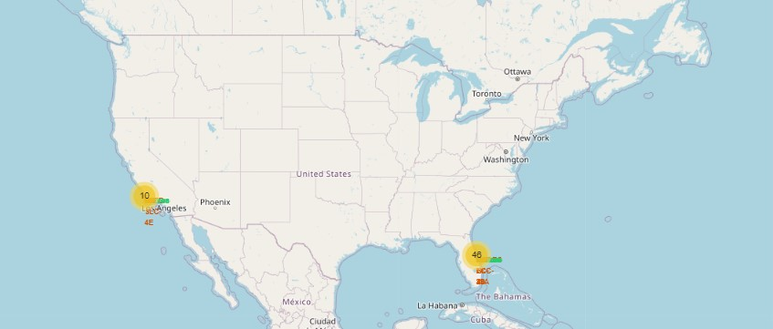
Results
With interactive analytics was possible to see that the launches were made near to the sea:

Slide 19
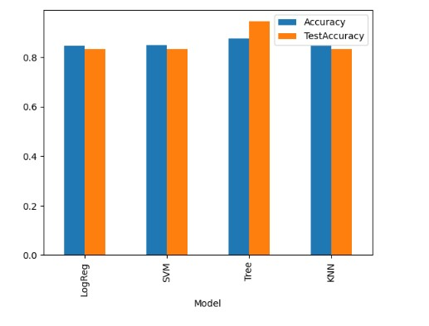
Results
The predictive analysis results showed that the best model which we can use is the decision tree.

Slide 20

Section 2

Slide 21
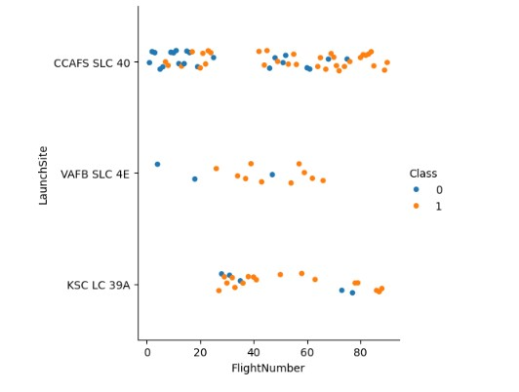
Flight Number vs. Launch Site
The majority of launches were made on VAFB SLC 4E was successful.
The majority of the launches were made on CCAFS SLC 40.
The successful rate increase over the time.

Slide 22
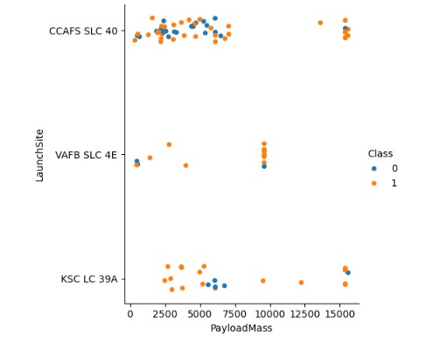
Payload vs. Launch Site
Most launches over 12000Kg were a success and only possible in CCAFS SLC 40 and KSC LC 39A
The 9000 KG launchers at VAFB SLC 4E were mostly successful

Slide 23
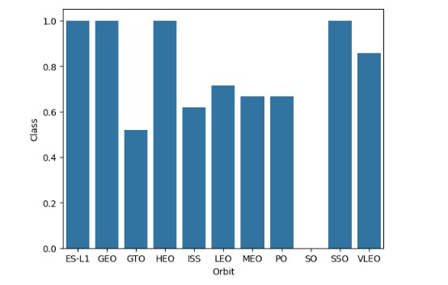
Success Rate vs. Orbit Type
The Orbit with more success in average were:
ES-L1
GEO
HEO
SSD

Slide 24
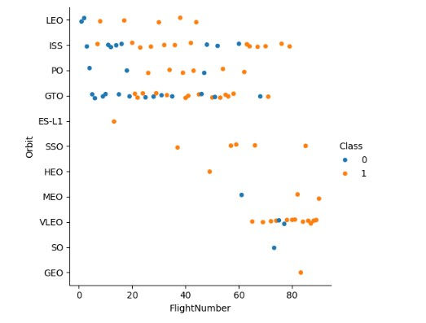
Flight Number vs. Orbit Type
VLEO that start recently shown a great success rate.
The success increase over the time.

Slide 25
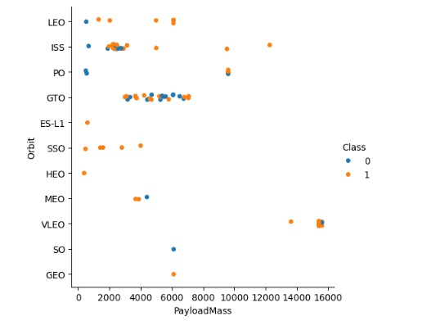
Payload vs. Orbit Type
Apparently there aren’t a relationship between the success rate with the Orbit and Payload Mass.

Slide 26
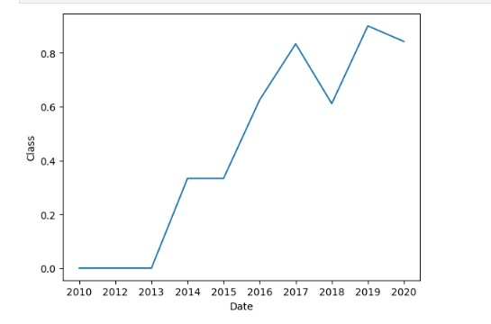
Launch Success Yearly Trend
The success rate increase over the time from 2013.
In 2018 and 2020 decrease a little bit but nothing worried.

Slide 27
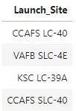
All Launch Site Names
Selecting unique ‘Launch_Site’ found that there are four launch sites.

Slide 28
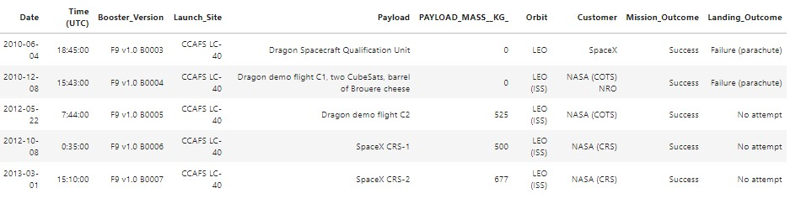
Launch Site Names Begin with 'CCA'
The first launch that begin with ‘CCA’ start in 2010-06-04.
Found this was possible selecting all the records where the Launch_Site was ‘CCA’.

Slide 29
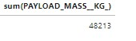
Total Payload Mass
Found this was possible summing Payload mass where the customer was the NASA (CRS)

Slide 30
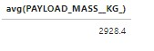
Average Payload Mass by F9 v1.1
Found this was possible selecting average payload mass carried where the booster version was F9 v1.1.

Slide 31
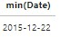
First Successful Ground Landing Date
Found this was possible selecting de the min Date where the Landing_Outcome was 'Success (ground pad)’.

Slide 32
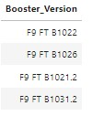
Successful Drone Ship Landing with Payload between 4000 and 6000
Found this was possible selecting distinct Booster_Version where Landing_Outcome was 'Success (drone ship)' and PAYLOAD_MASS__KG_ between 4000 and 6000

Slide 33
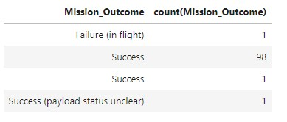
Total Number of Successful and Failure Mission Outcomes
Found this was possible selecting Mission_Outcome, count(Mission_Outcome) and then grouping by Mission_Outcome.

Slide 34
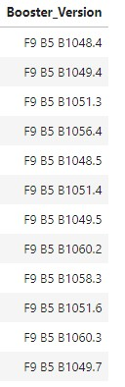
Boosters Carried Maximum Payload
Found this was possible selecting the Booster_Version and then filtering the PAYLOAD_MASS__KG_, this was possible using a subquery where select the max PAYLOAD_MASS__KG_

Slide 35
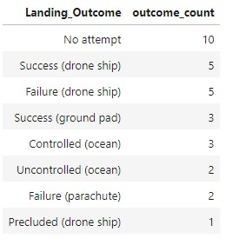
Rank Landing Outcomes Between 2010-06-04 and 2017-03-20
There are a lot of Landing_Outcome that ‘No attempt’.
This was possible selecting Landing_Outcome, COUNT(*) AS outcome_count, WHERE Date BETWEEN '2010-06-04' AND '2017-03-20' GROUP BY Landing_Outcome ORDER BY outcome_count DESC;

Slide 36

Section 3

Slide 37
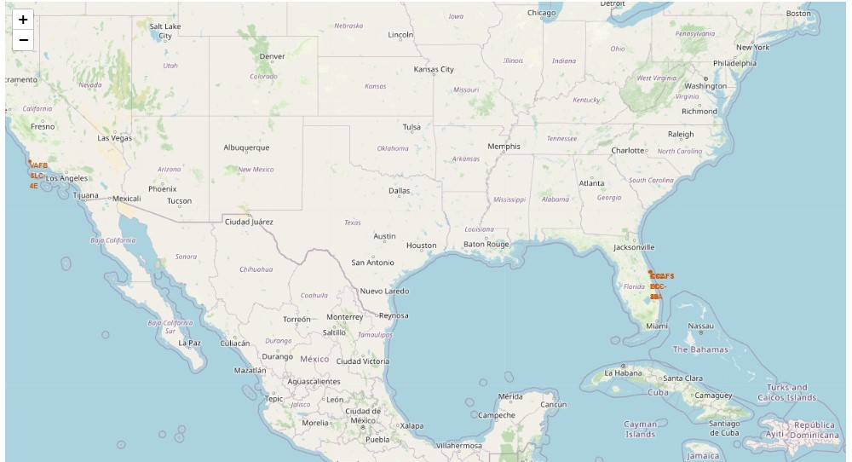
Map with all launch sites
The launch site are so near to the sea.

Slide 38
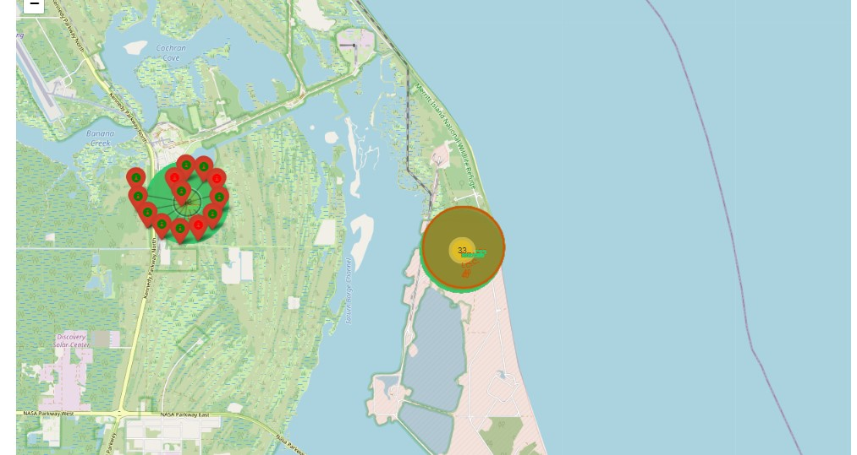
Launch Outcomes
The area where there a lot of launch outcomes, the green marker means success and the red means fail.

Slide 39
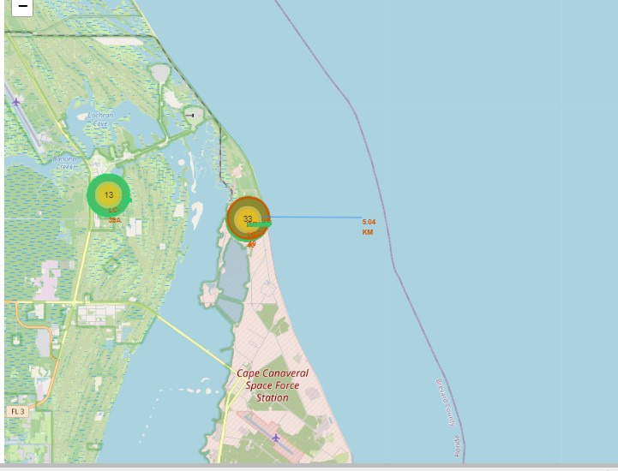
Line to the coast
In the map we can see a line and the distance between one launch site and the a point.

Slide 40

Section 4

Slide 41
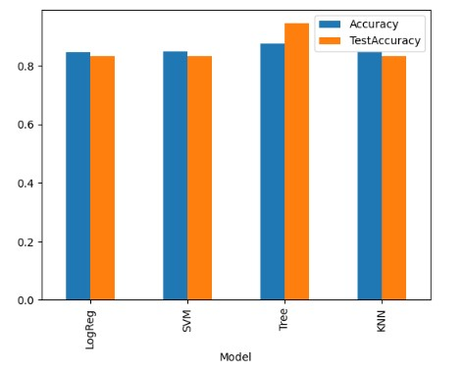
Classification Accuracy
The Classification model with most accuracy and test accuracy was de Decision Tree model.

Slide 42
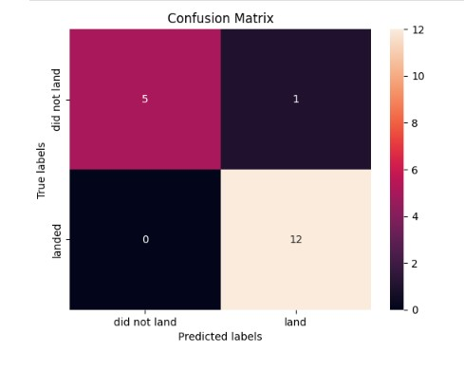
Confusion Matrix
The Confusion Matrix shown as 5 of 6 attempts acert that did not land, and 12 of 12 attempts acert that did land.

Slide 43
Conclusions
The success rate increase over the time.
The launch sites are near to the coast.
Apparently there aren’t a relationship between the success rate with the Orbit and Payload Mass.
The Decision Tree is the best model for our purpose.

Slide 44


